Slide 1


OLIST
ECOMMERCE
Sales and Profit Analysis
GROUP -6
Rohit Prakash Dandade
Pooja Vasdev
Syed Murtuza Ali
Himaja Naga Varshini Mallem
Teja Pachipulusu
Saroj Kumari

Slide 2
AGENDA
Company History
Objective
KPI-1 : Weekend Vs Weekday payment statistics
KPI-2 : No.of orders by review score “5”and payment type as credit card.
KPI-3 : Average no.of days taken for order delivery for pet shop.
KPI-4 : Average price and average payments for Sao Paulo city.
KPI-5 : Average shipping days Vs Review score.
Excel Dashboard
Power BI Dashboard
Tableau Dashboard
Challenges faced
Summary
Recommendations

Slide 3
COMPANY HISTORY
OBJECTIVE
Olist operates as a marketplace, connecting the sellers with customers.it was founded in 2016 by Tiago Dalvi and initially started as a tool for small and medium sized businesses to list their products online.
The Olist store analysis project aims to analyse customer purchasing patterns and payment statistics on an e-commerce platform, olist . Project covers several KPI’S such weekday vs weekend sales , payment statistics ,delivery time and customer behavior.The analysis is based on 9 CSV files , which are cleaned and manipulated to extract valuable insights.
Olist is a Brazilian e-commerce platform that provides a wide range of services to its sellers including logistics, marketing, and customer service support.

Slide 4
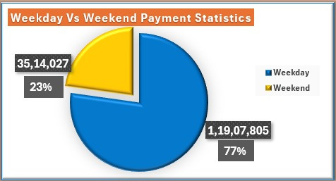
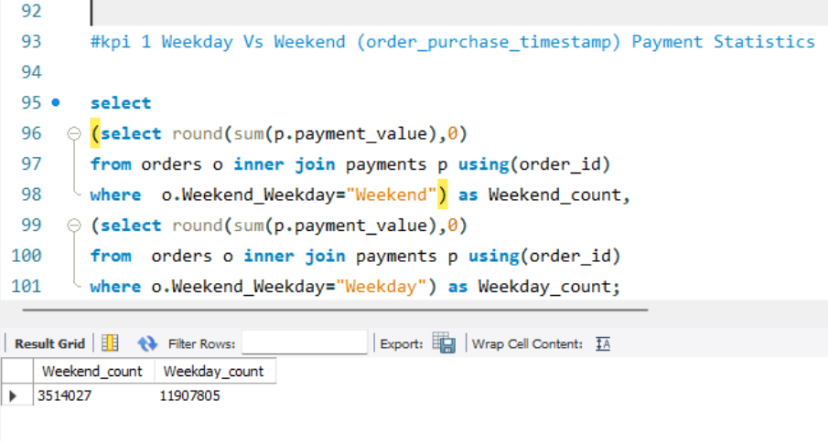
KPI 1: Weekday Vs Weekend (order_purchase_timestamp) Payment Statistics
Observations :
Total payments : 16.01M
Weekend Payments : 3.5M(23%)
Weekday Payments : 11.9M(77%)
Our payment statistics reveal a clear trend between weekdays and weekends. The data shows that the majority of transactions, totaling 11.9 million payments, occur during the workweek, representing 74.4% of the total. Conversely, weekends see 3.5 million payments, making up 25.6% of the total volume.

Slide 5
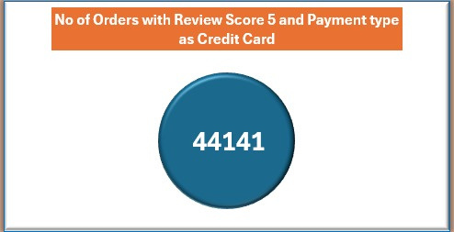
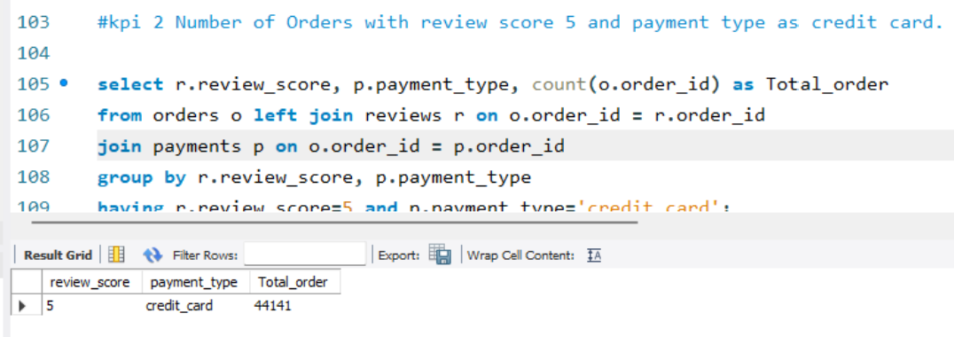
KPI 2: Number of Orders with review score 5 and payment type as credit card.
Observations :
No. of orders by review score 5 and payment type as credit card : 44141
Out of 100,000 total orders, a substantial 44,141 orders stand out with a top-notch review score of 5. These orders specifically used credit cards for payment. This signifies a strong preference for credit card transactions among customers who have rated their experience with the highest satisfaction.

Slide 6
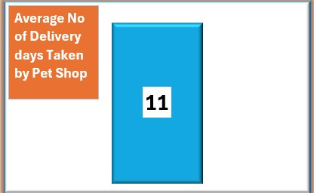
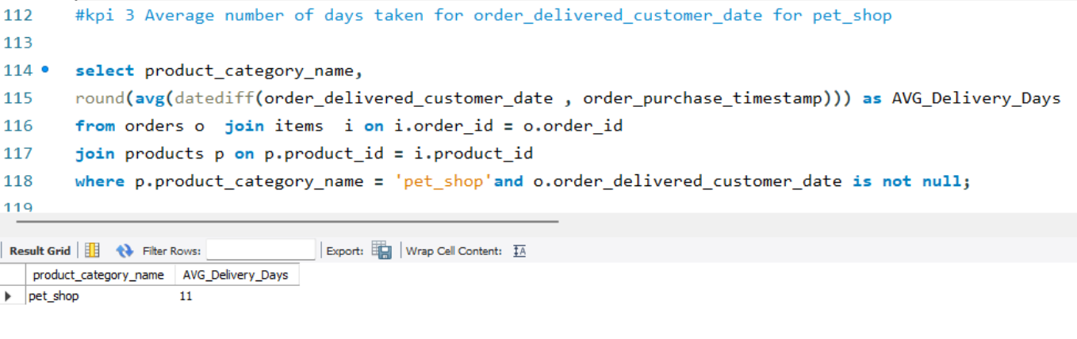
KPI 3 : Average number of days taken for order_delivered_customer_date for pet_shop
Observations :
Average no. of delivery days taken by pet shop : 11 Days
On average, orders from pet shop take 11 days to be delivered to customers. This metric provides insight into the typical delivery timeline, they can improve delivery time and maintain customer satisfaction.

Slide 7
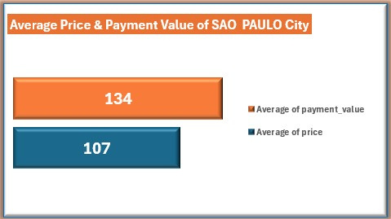
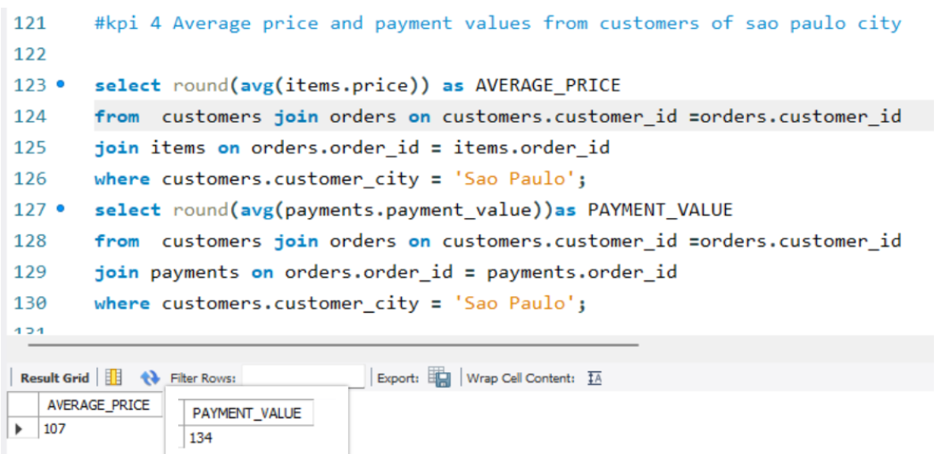
KPI 4 : Average price and payment values from customers of Sao Paulo city
Observations :
Average price for Sao Paulo city : $107
Average payment value of Sao Paulo city : $134
Here Avg price and Avg payments are increasing gradually every year.
The average price of goods in Sao Paulo city is $107, while the average payment value, is $134. This data offers a comprehensive view of the typical transaction amounts in Sao Paulo city.

Slide 8
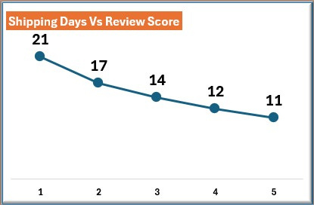
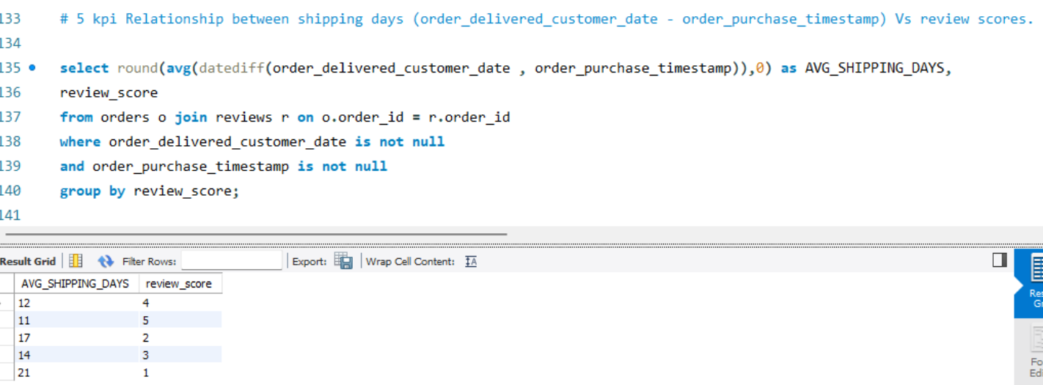
KPI 5 : Relationship between shipping days (order_delivered_customer_date -order_purchase_timestamp) Vs review scores.
Observations :
Here shipping days and review score are inversely proportional.
It helps in understanding the impact of delivery time on customer satisfaction levels. Olist can use this information to optimize their logistics and improve their delivery time.

Slide 9

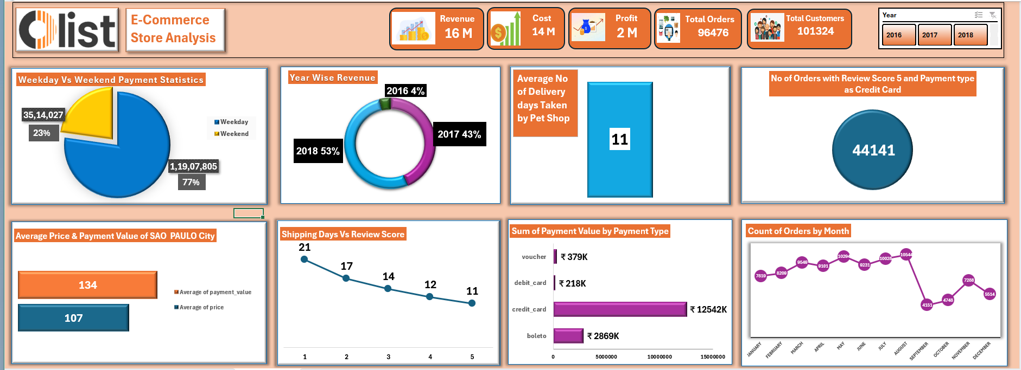
SALES ANALYSIS DASHBOARD USING EXCEL

Slide 10
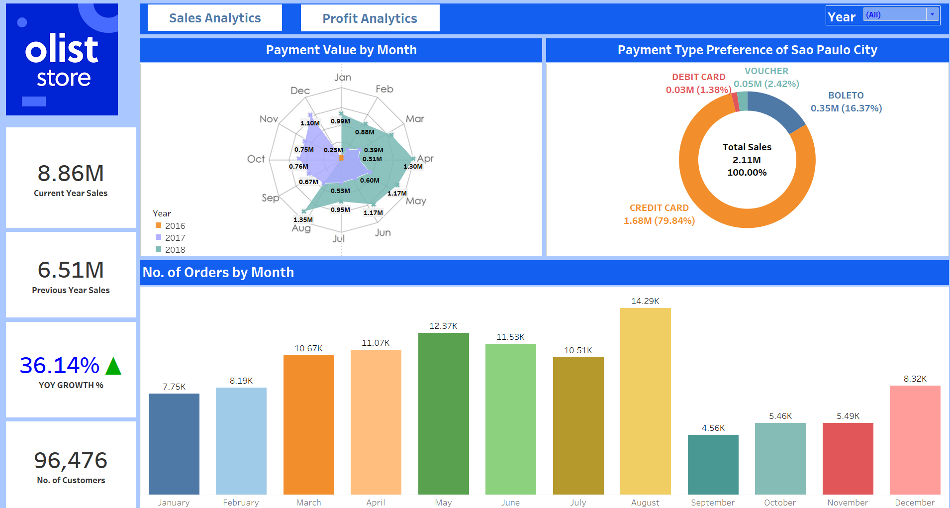
SALES ANALYSIS DASHBOARD USING TABLEAU

Slide 11
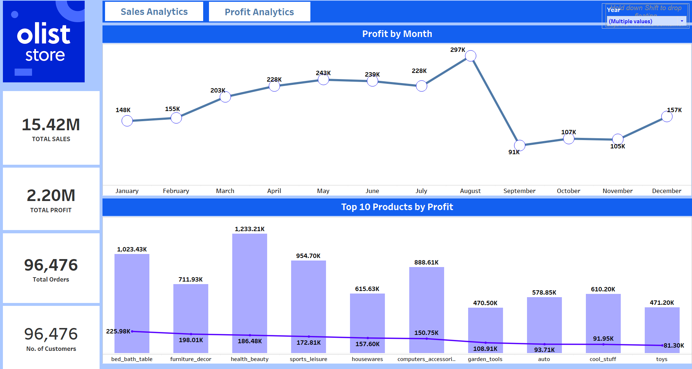
PROFIT ANALYSIS DASHBOARD

Slide 12
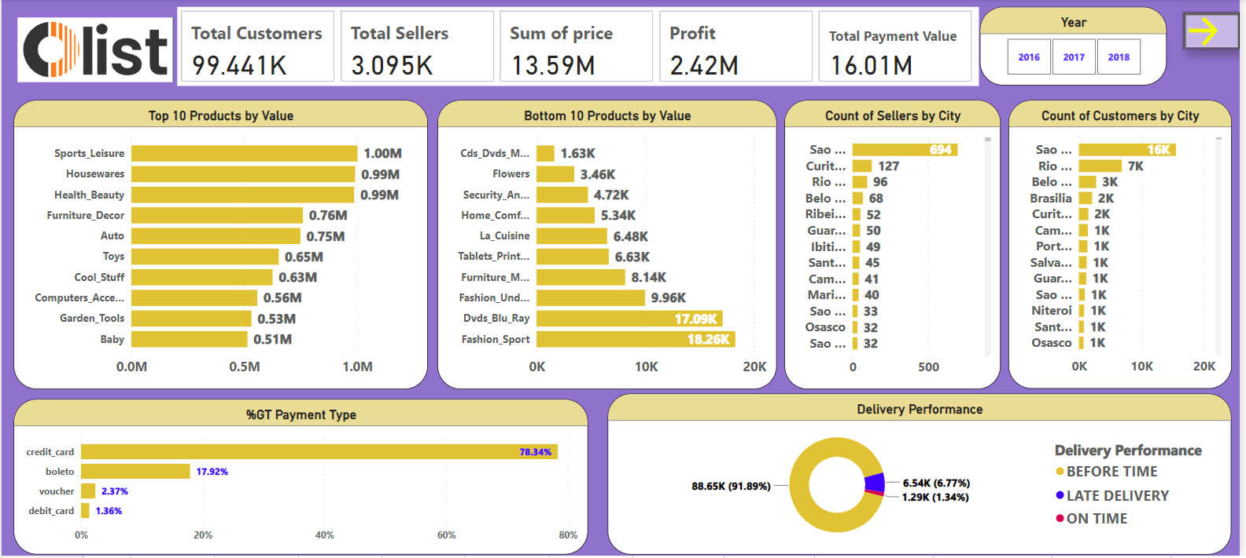
SALES ANALYSIS DASHBOARD USING POWER BI

Slide 13
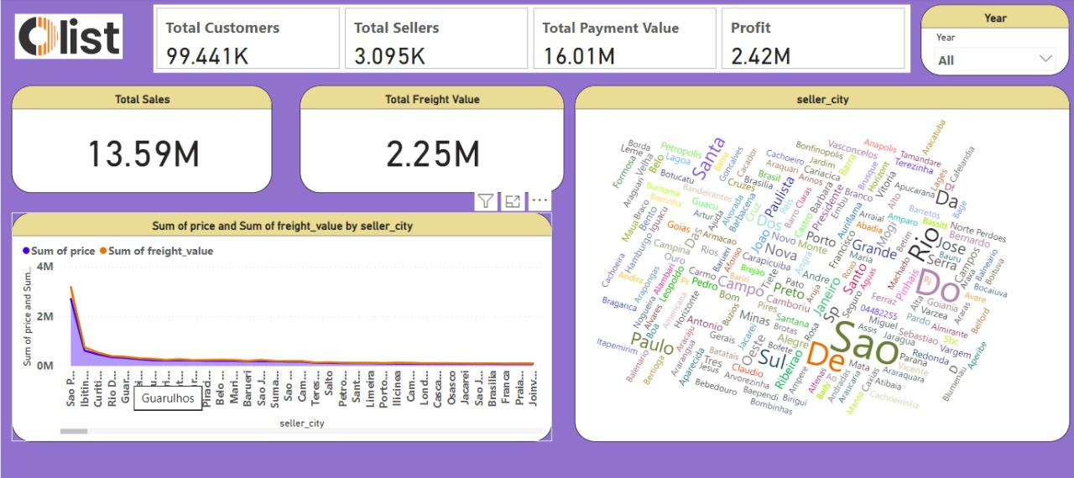
SALES ANALYSIS DASHBOARD USING POWER BI

Slide 14
Summary
Olist offers a comprehensive solution to key challenges in the e-commerce industry, leveraging its innovative platform and services. Positioned in a rapidly growing market, Olist stands out with its scalable business model and commitment to customer satisfaction. With its unique value proposition, Olist is poised for significant growth and impact in the e-commerce landscape.

Slide 15
Recommendations
Implement data-driven marketing strategies for effective customer acquisition and retention.
Prioritize customer satisfaction to maintain a competitive advantage.
Regularly evaluate performance and adapt business strategies accordingly.

Slide 16
CHALLENGES FACED
Orders dataset and Review dataset has null values, and they are replaced by correct numerical values/strings.
We saw duplicate values in geolocation dataset , they are dropped using “Remove duplicates” in power query.
We saw special characters in city names in geolocation dataset and they are corrected using “Replace” in power query.

Slide 17

THANK YOU

